Slide 1
Approaching NELA data

Slide 2
How to access & process your NELA data
(Short) guide to run charts
(Even shorter) intro to SPC

Slide 3
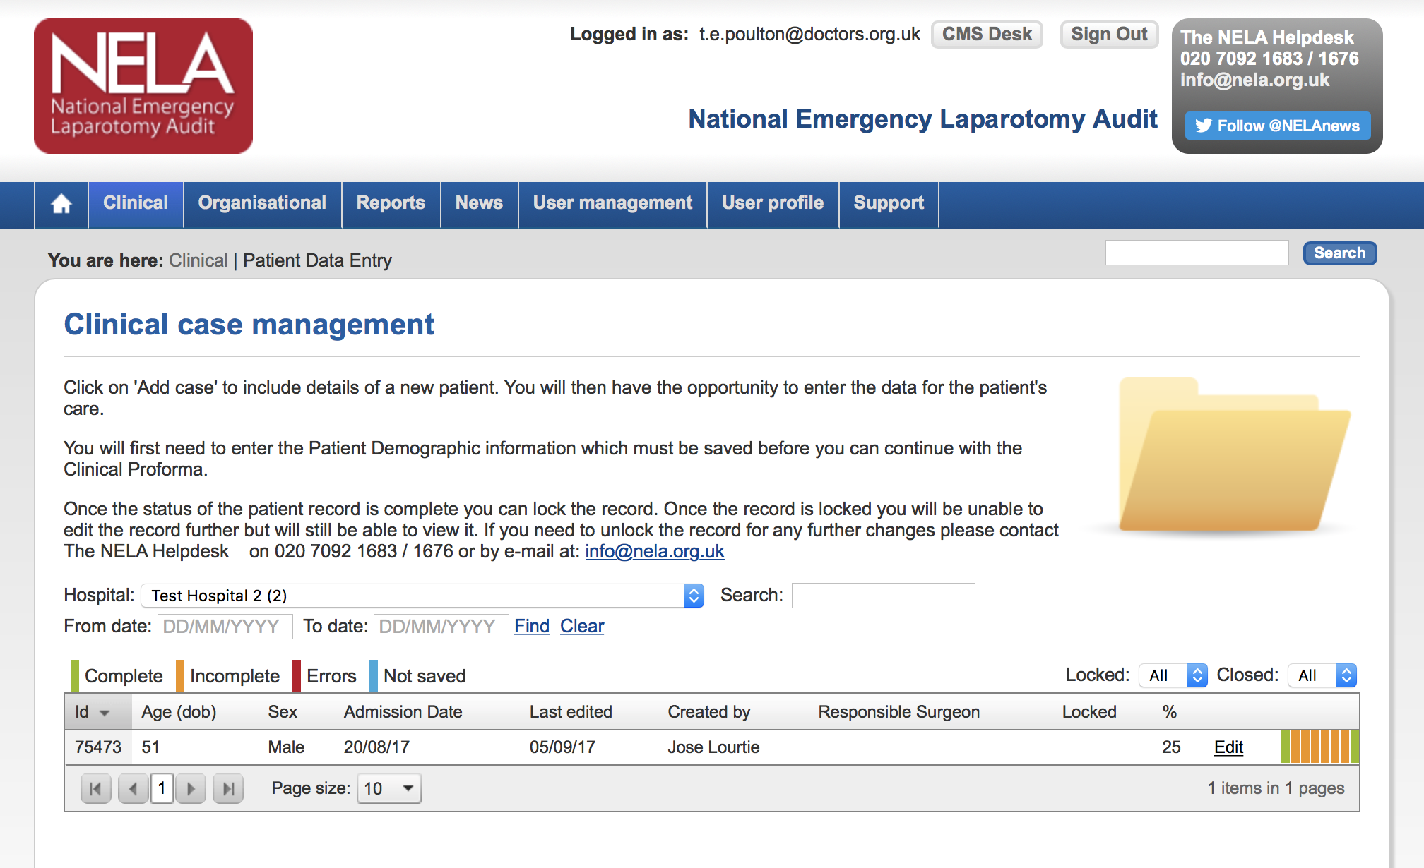
Log in to your NELA data….

Slide 4
Access QI dashboard reports

Slide 5
Access QI dashboard reports
Chose date range
Chose locked/unlocked

Slide 6
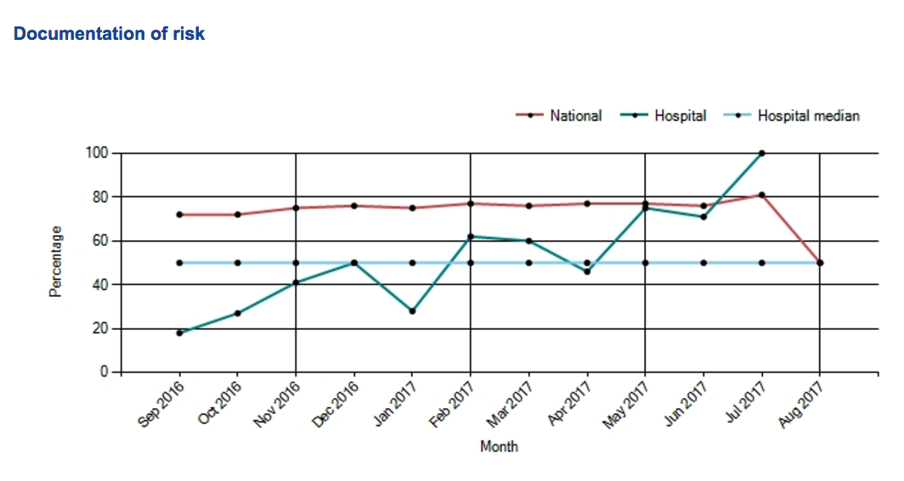
Access QI dashboard reports
National data
Hospital median
Hospital data

Slide 7
Exporting dataset

Slide 8
Exporting data

Slide 9
NELA data approaches: using run charts

Slide 10
Establishing measures
Outcome measures
Reflect the impact on a patient and demonstrate the end result of doing things
NELA outcomes are mortality, length of stay and complications (unplanned returns to theatres, unplanned admission to ITU)
Process measures
Reflect the things that you do (processes) and how systems are operating
NELA process measures include admission to ITU, treatment parameters in sepsis, consultant delivered care etc etc

Slide 11
Why use a run chart?

Slide 12
Why use a run chart?

Slide 13
Run chart
Line graph where your measure (y-axis) is plotted over time (x-axis)
Usually plotted with a median
Effects of changes or interventions can be easily visualised and understood over time

Slide 14
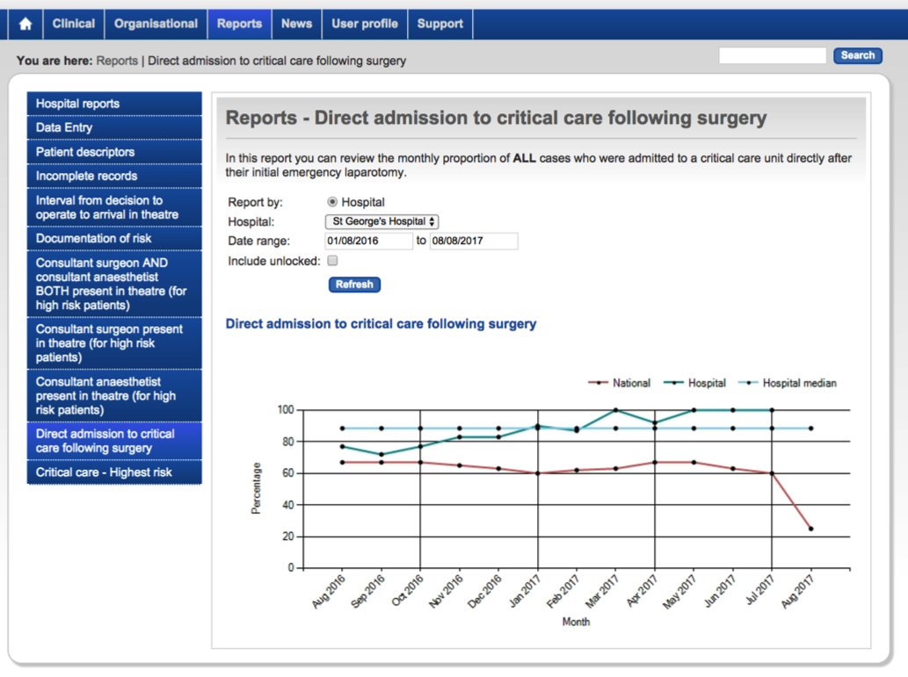
Run chart

Slide 15
Run chart rules- 1. Trend - 6 data points moving in same direction

Slide 16
Run chart rules: 2. Shift - 5 data points in a row below/above the median line

Slide 17
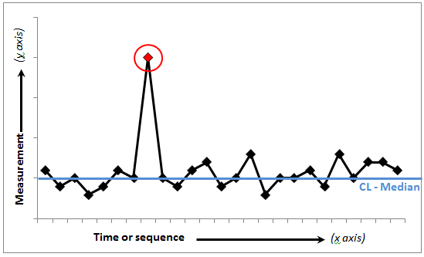
Run chart rules: 3. Astronomical data point

Slide 18
NELA data access: A short bit on SPC charts

Slide 19
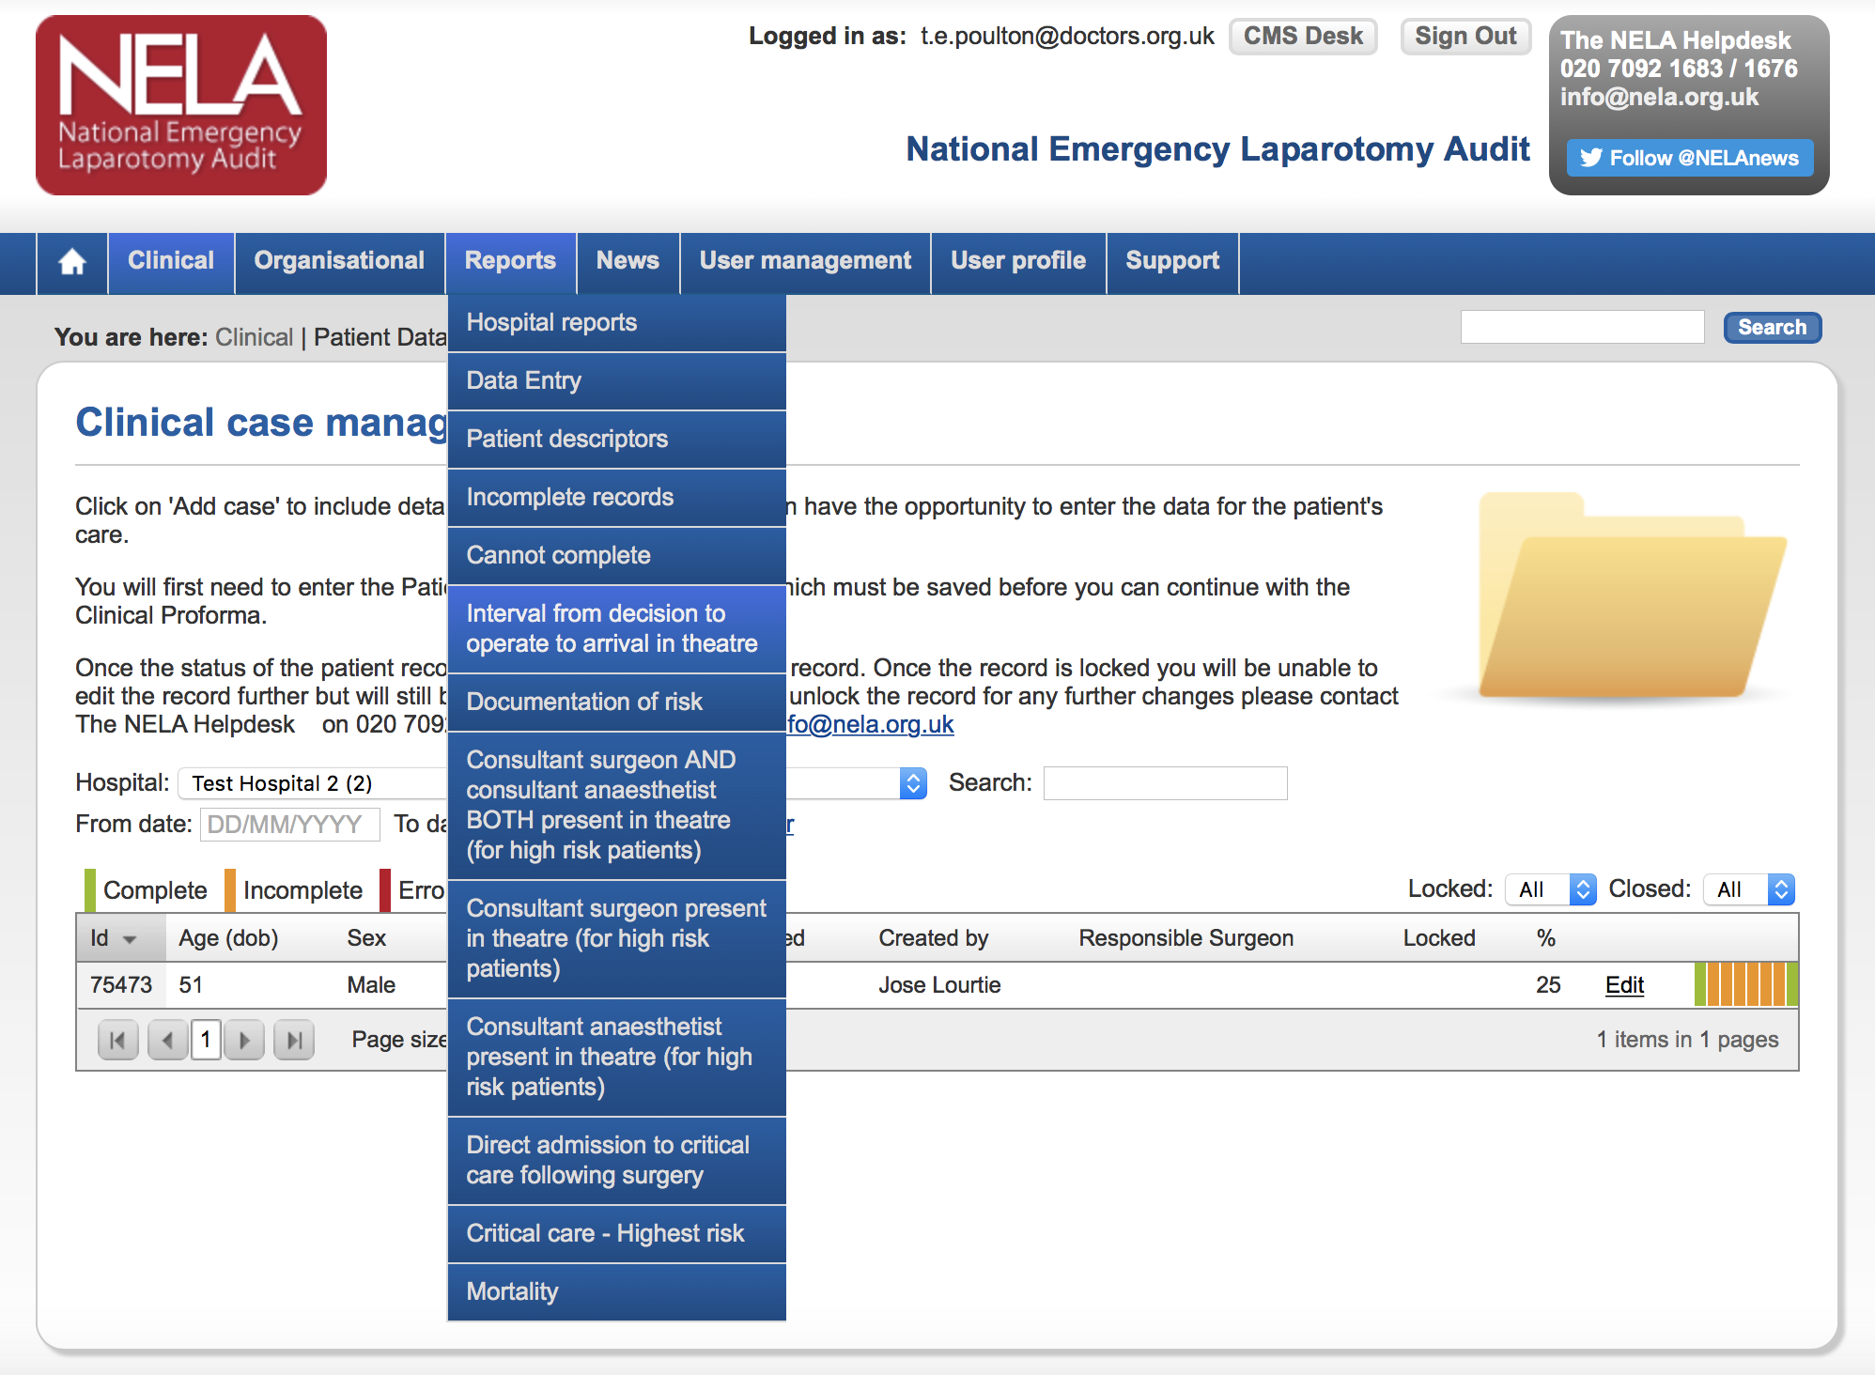

Slide 20
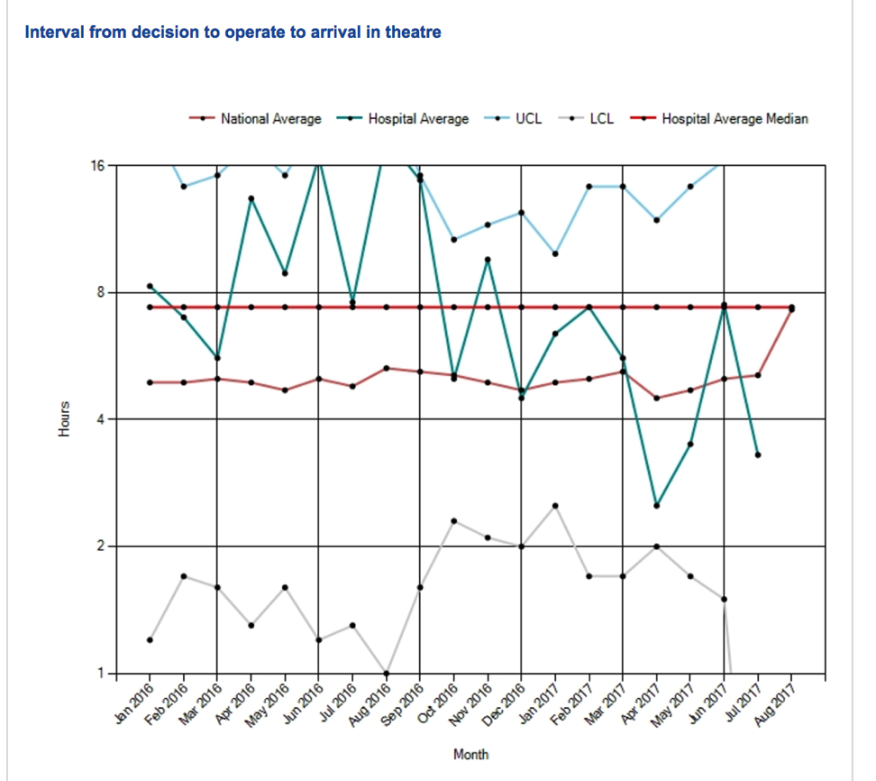
SPC (Shewhart) chart
Control limits
Set mathematically, if measures go outside these then the process is not stable
Control limits

Slide 21
Recap of this session
Understand how to access and manipulate your NELA data
Understand the basis for using run charts and some simple rules of interpretation
(Introduction to SPC charts)

Slide 22
Any questions?

